Slide 1
Increasing Students’ Literacy and Social-Emotional Health through Horse Powered Reading
Dr. Sally A. Baas -baas@csp.edu
Dr. Michele Pickel - pickel@csp.edu
Cross P Ranch / Concordia University- St. Paul MN
MSPA 2018 Conference
Minneapolis, MN

Slide 2
Laying the Foundation
Children experience and perceive a range of emotions.
Early positive interactions promote emotional wellness throughout the lifespan.
Having appropriate expectations of children's development is important.
Parents and caregivers should be mindful of their own emotional well-being, seeking support if they need it.
Children are resilient and, if properly supported, can overcome potentially traumatic events.

Slide 3
Themes addressed:
Working with children who experience mental health issues
Supporting schools, families and children in times of crisis
Developing strategies to support children with learning difficulties
Helping schools to become safe and effective learning environment

Slide 4
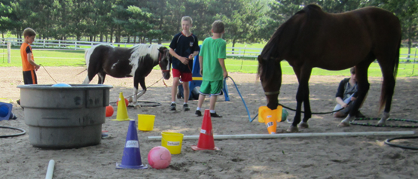
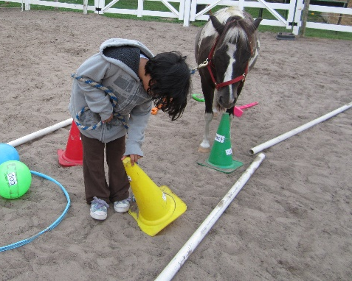
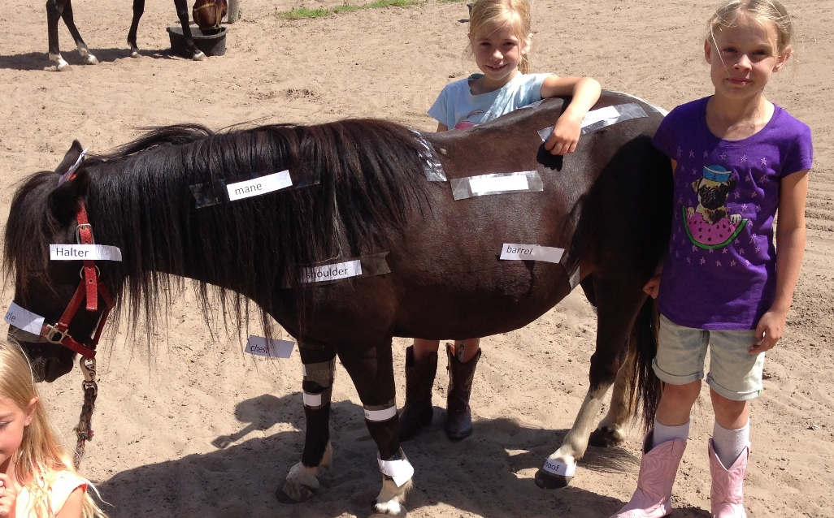
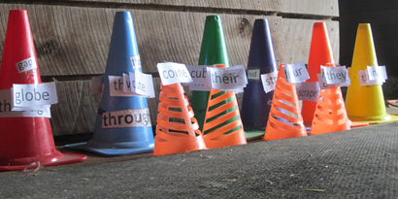
Horse Powered Reading?
Comprehension
Fluency
Vocabulary
Decoding
Notes:
You may already be aware of Equine Assisted Therapy such as Therapeutic Riding programs or Hippotherapy – I do have people from PATH (Prof. Assoc. of Therapeutic Riding) who take my online course to overlay HPR on their programs -- But today, that’s not what I’m talking about. Today I’ll be sharing EAGALA Model HPR in which ALL activities with the horses are done ON THE GROUND, and WITH a Mental Health Professional.
EAGALA Model HPR seamlessly INTEGRATES SOCIAL EMOTIONAL LEARNING with ACADEMICS. EAGALA Model Equine Assisted Learning (www.eagala.org) helps students see and experience reading with their entire mind, body and emotions by creating metaphors for the skills involved in reading. Horses become the reading material or book students need to connect with. In a Horse-Powered Reading session reading problems are made visible by labeling obstacles that get in the way of understanding.
From The Power of Moments by Chip & Dan Heath: “Let’s have people DO something active and immersive. THAT’S going to generate more of an emotional response so they will FEEL something. THEN they can THINK about what they’ve learned.

Slide 5
Learning Success Formula
A Few Key Reading Skills
+
Motivation
+
Self-Efficacy
+
_________Persistence_________
A Synergy that creates EXPONENTIAL learning
.
Notes:
Like a TIME RELEASED CAPSULE

Slide 6
Unwrapping GREATNESS

Slide 7
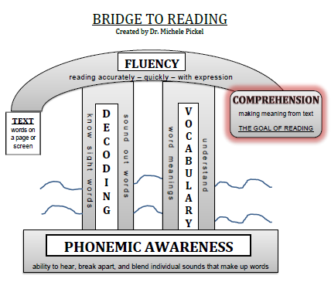
Notes:
Thanks to the National Reading Panel – 5 Key skill areas

Slide 8
Decoding:
  100 Word List
  37 Key Phonograms (rimes)
  Magic “e”
  Vowel & Consonant Digraphs
Mighty Mini Must-Do
Reading Skills
Compiled by Dr. Michele Pickel
Vocabulary:
  Prefixes and Suffixes (Affixes)
  Multiple Meaning words
  Root words (Morphemic Analysis)
  Word PLAY
Fluency:
  Accuracy
  Speed (appropriate)
  Prosody (Expression)
Comprehension:
  Make Connections
  Asking Questions
  Predict and Infer
  Visualize – Mental Movies
  Get to Know Characters
  Non- Fiction
Fun Flow –Challenging but Not Too Hard
Strong Emotion –“REMEMBER THIS”
Metaphors – Make Connections
Make it Physical
Apply the Learning
Notes:
Biggest Bang for your Buck!

Slide 9
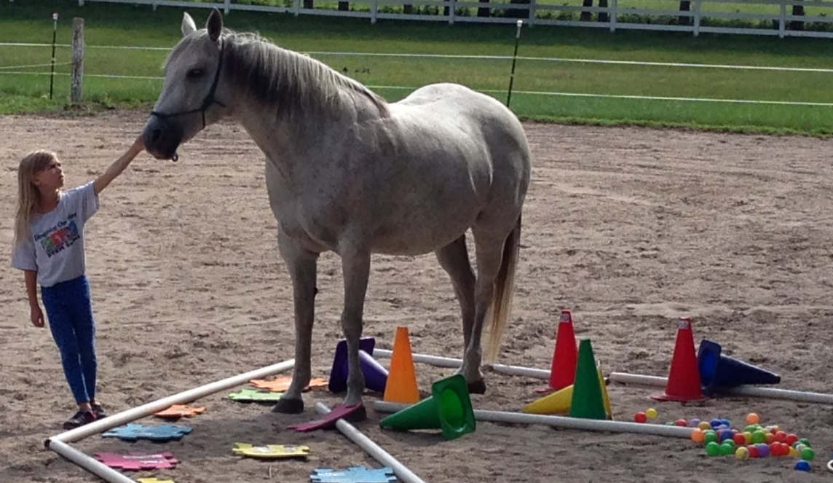
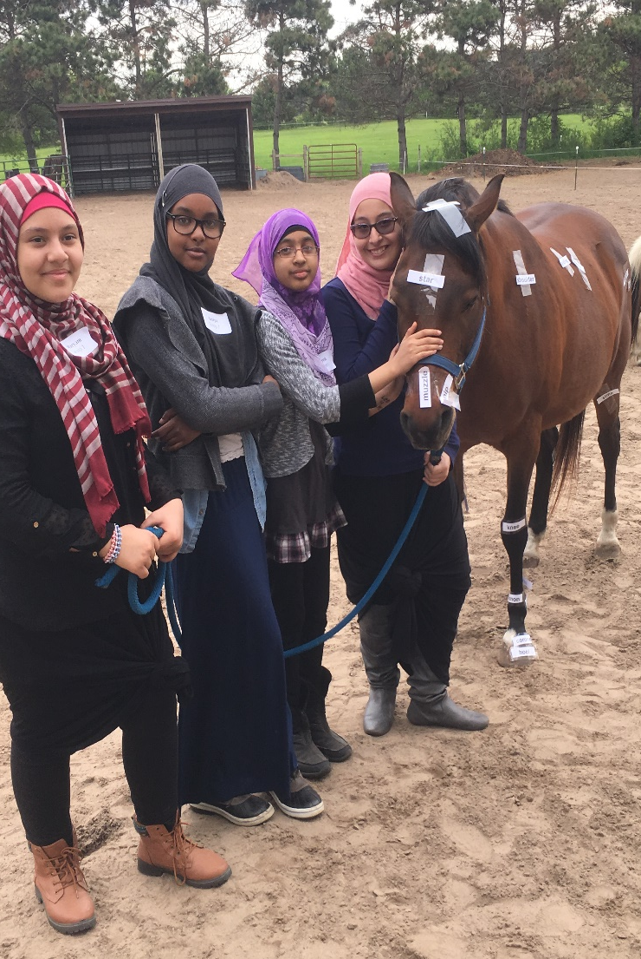
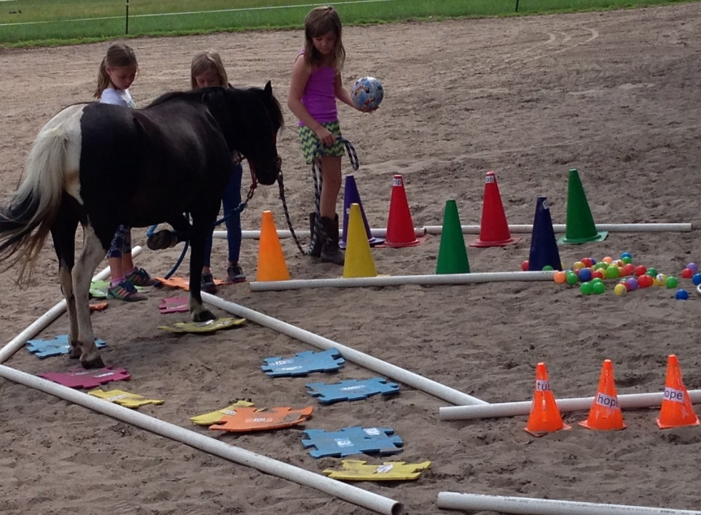
Why Horses?
Notes:
Horses can influence people in very powerful ways. Accomplishing a task with the horse, in spite of fears, creates confidence and provides wonderful metaphors for dealing with other challenging situations like those faced by struggling readers at school.
So often, it’s not really about the reading skill, but about the social emotional JUNK that is blocking student learning. Sometimes home/family, sometimes school, sometimes simply different ways of learning.
With HPR, students experience reading with their entire mind and body and emotions as they creating metaphors with the horses and activities for the skills they struggle with in reading.
Horse Powered Reading not only teaches reading skills, but perhaps even move important: it enhances Motivation, Self Efficacy /self confidence, and Persistence!

Slide 10
Notes:
EAGALA is Equine Assisted Growth and Learning Association. HPR builds on the four key standards of the EAGALA model:
Two things to take special note of
1) the team includes a Mental Health Professional
2) All work is done on the ground – THERE IS NO RIDING!

Slide 11
Research Based Reading Strategies
+
EAGALA model activities
EAGALA Model Horse Powered Reading
Structuring Horse Experiences
“…The ideas and ways of structuring sessions on the ground with horses are infinite. Within these possibilities, there are common categories which may assist in the design process.”
Notes:
So HPR combines reading strategies that are RESEARCH Based with Eagala model activities. Yes, you can teach reading using adaptations of many of the activities, but it is the HORSES that provide the real power boost to launch student motivation, self-efficacy, and persistence!
Given more time, I could go into the specific research base and whys and hows of Motivation, Self-efficacy, and persistence, but suffice it to say, the research backs up all that the horses are doing to teach SEL

Slide 12



The NHA Core Methodologies:
The 3 Stands™
Absolutely No!
Absolutely Yes!
Absolutely Clear!

Slide 13
FANAFI – Find A Need And Fill It!
  Reading Crisis in our schools and homes
    60% of all students are reading below grade level
  Frantic parents – “Where can I get help for my child? Help her PLEASE!”
    Report cards - Pressure – homework hassles- time crunch
    Jaida’s mom
  Desperate teachers – “I’m NOT a social worker!”
    More curriculum to teach – merit pay based on test scores
    Cole’s Teacher
  Struggling students – “I don’t want to do it; I can’t do it; I GIVE UP!”
    Tests and more tests
    Anxiety, depression, behavior concerns in young children
Notes:
The SECRET to SUCCESS! FANAFI

Slide 14
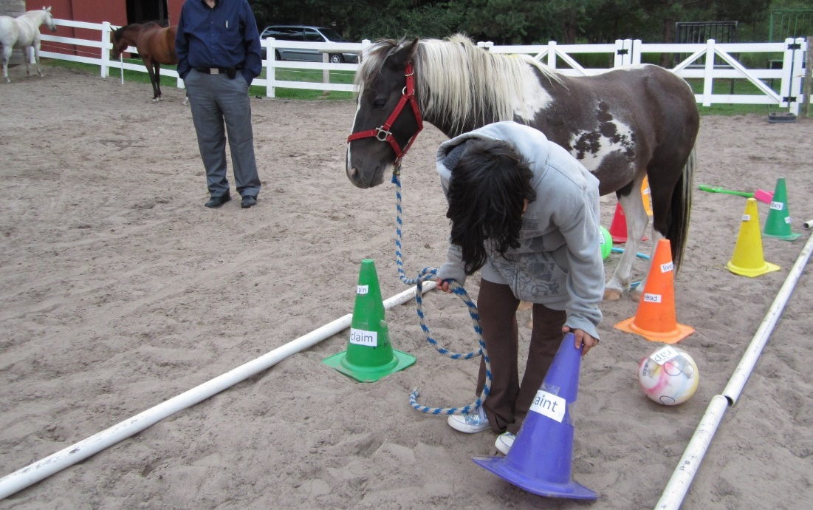
FANAFI – Find A Need And Fill It!
  Reading Crisis in our schools and homes
    60% of all students are reading below grade level
  Frantic parents – “Where can I get help for my child? Help her PLEASE!”
    Report cards - Pressure – homework hassles- time crunch
    Jaida’s mom
Notes:
The SECRET TO ALL SUCCESS: FANAFI!!
These are some of the needs HPR is filling; Reading crisis; Parent concerns, Teacher concerns, student needs.
Jada LOVED Benny (the book), but as you can see from her road to reading, things were a little overwhelming for her. As she created her road and added the words, they all clustered right at the beginning, so even getting started through the first several words was difficult.
At the end of the session, she wanted to simply “hold her book” and “look at the pages” with Benny’s head on her chest.
BUT
There were other force working against that!
The two others in the top left corner plus one you can’t see in the photo, immediately surrounded descended on Jada and her book trying to nip at her book.
For safety reasons, we “teachers/facilitators” formed a sort of blockade around them, allowing them some “independent silent reading” time.
Later, just before they left, I asked mom, “Are there things in Jaida’s life she feels are “nipping at her?”
With a startled look on her face, mom suggested that maybe it was her older, sister who excelled in school… and maybe mom and dad who all three constantly encouraged/nagged at Jaida to try harder and do better.
The following session, Mom was practically in tears as she shared her realization that the nipping was also the many extra curricular activities that she had to do each week (piano, gymnastics, violin, tutoring, swimming)

Slide 15
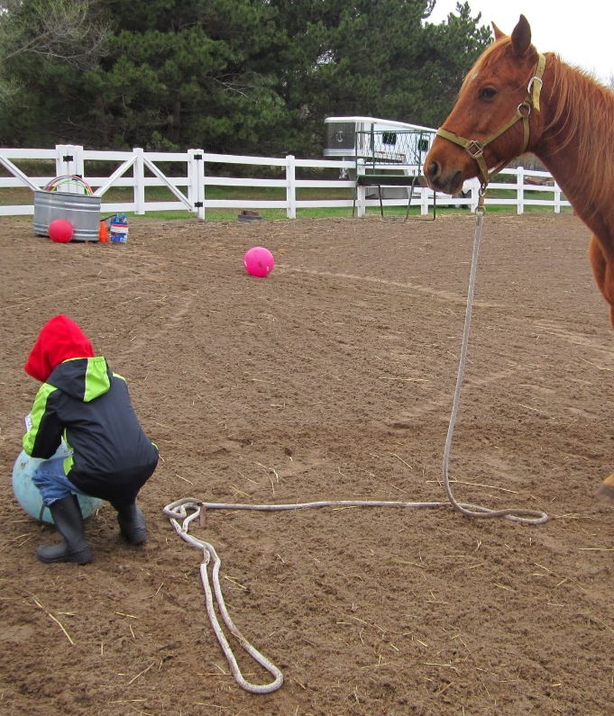
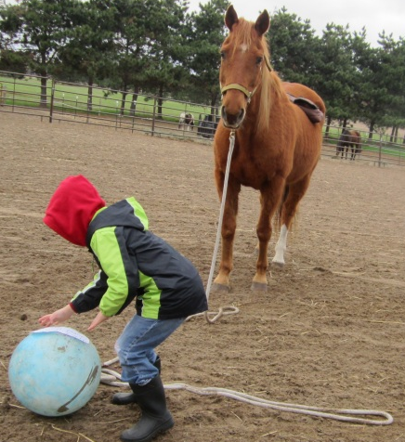
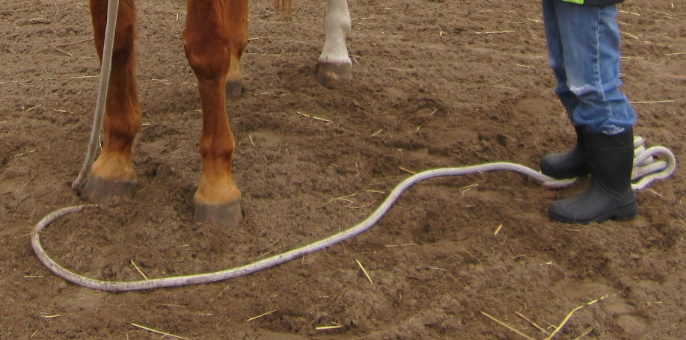
FANAFI – Find A Need And Fill It!
  Desperate teachers – “I’m NOT a social worker!”
    More curriculum to teach – merit pay based on test scores
    Cole’s Teacher
Notes:
Teaching a graduate Elementary Literacy Instruction class, I shared my idea of HPR with the teachers taking the course saying, “Now I just need to find some students to try it out with”. Immediately, a first grade teacher said, “I have just the kid for you! I just can’t figure out what’s going on with him that he Doesn’t

Slide 16
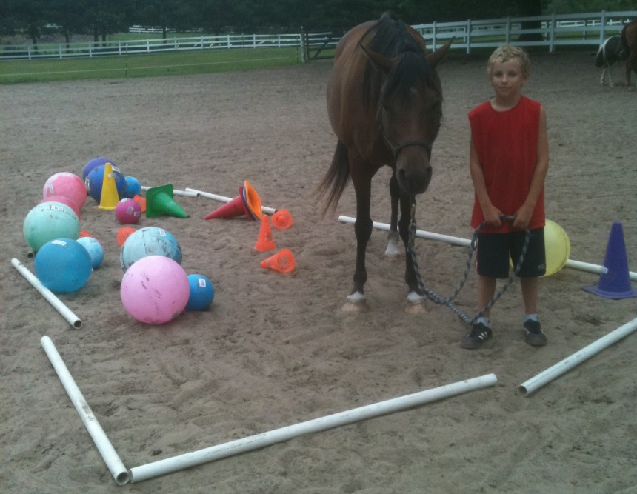
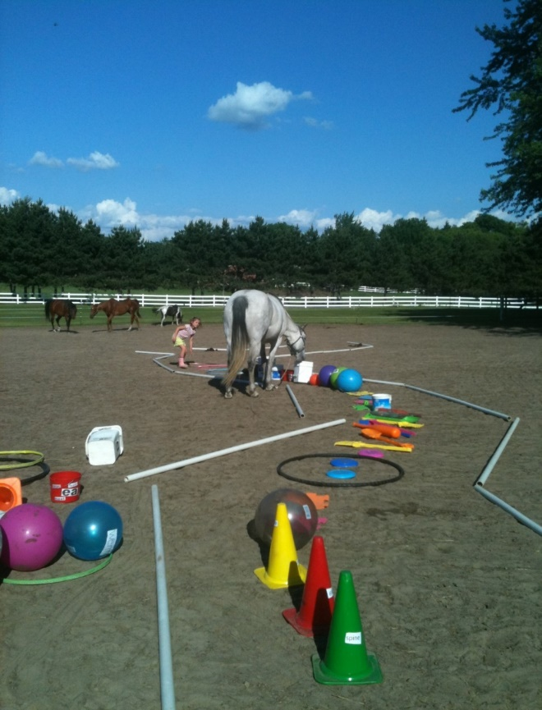
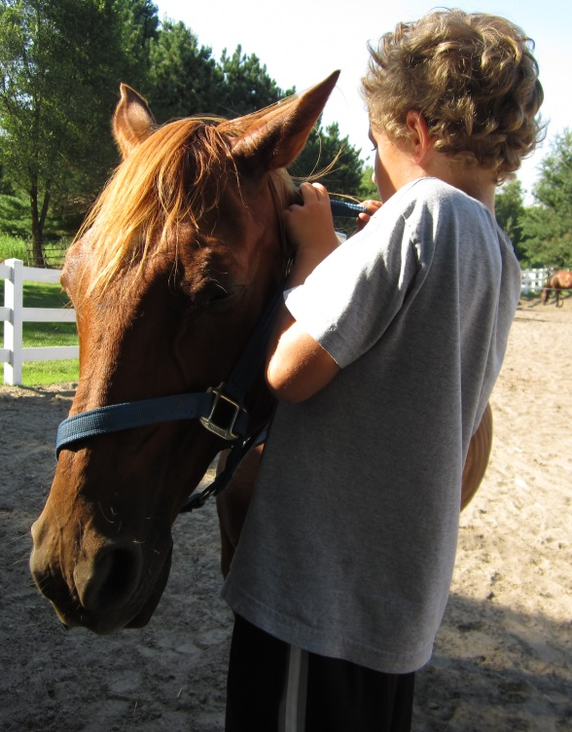
FANAFI – Find A Need And Fill It!
  Struggling students – “I don’t want to do it; I can’t do it; I GIVE UP!”
    Tests and more tests
    Anxiety, depression, bullying, behavior concerns
Notes:
As MH professionals, you KNOW the struggles your students face day in and day out!
Often it starts out with “I don’t want to read it” -- then it becomes “I can’t read it”, and finally “I give up – I won’t even try to read it”
MK – struggled with anxiety – notice how TIGHTLY CONSTRUCTED her Road to Reading is. No wiggle room to fail or make a mistake! No room for her BOOK to get through,
Colton – Encephalitis as a 1 yr old left him with some cognitive and physical challenges. His left hand didn’t work quite right – so actually CONNECTING to his “book” was a challenge – Mom was in tears when after a significant struggle he succeeded.
He was also having trouble with words “rolling out” of his brain. He would read it and then the next time the word came up – it had rolled out of his brain. So I told him to build a better brain.

Slide 17
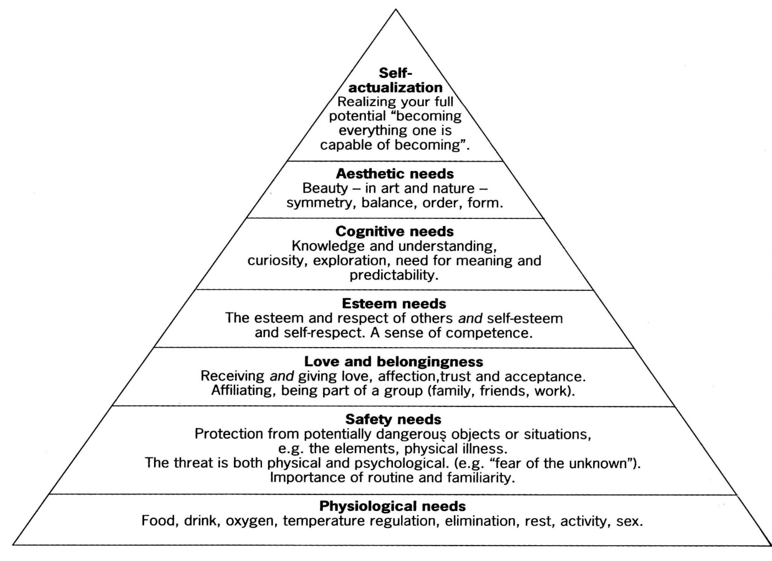
Maslow’s Hierarchy of Needs
Notes:
Jeanna, the MH I worked with doing a 4 week HPR research project with 1st-5th grade SPED kids in Wyoming a year ago made an astute observation:
She noticed the way the Special Ed kids responded to the horses and suddenly were able to read things that their teacher had been trying all year to teach them!! She realized that the horses were meeting their lower-level needs from Maslow’s hierarchy which amazingly then let them move up to reach for and fill their cognitive needs of knowledge and understanding, curiosity, exploration, need for meaning and predictability. When she first mentioned it a huge lightbulb went off in my head and took me back to my Ed Psych textbook section on motivation.

Slide 18

Deficiency Needs
The four lower-level needs--for survival, then safety, followed by belonging and then self-esteem, are the deficiency needs. When these needs are satisfied, the motivation for fulfilling them decreases. The student frees up cognitive energy previously needed to fill those needs, allowing them to move on to the three higher needs!
Notes:
In the case of HPR, most of the struggling readers seem to be stuck trying to deal with their deficiency needs. We have begun to realize and observe that those deficiency needs are actually being met by the HORSES! In the classroom and the other parts of life, those students feel concern about challenges at home and school where their physical and emotional safety may be threatened by bullying and academic struggle. They don’t ‘fit in’ because of their disability or low school performance, so consequently, their self-esteem is often very low.
In the arena however, the facilitators and especially the horses create a secure, safe place for students to work through and solve those challenges at their own pace and achieve success. The horses accept them for who they are and the entire process of working through challenges together builds their self-esteem.

Slide 19

Being Needs
Students are now free move on to the three higher needs! – cognitive needs, then aesthetic needs, and finally self-actualization -- the being needs. This freedom allows them to learn missing reading, or other cognitive skills that can make a huge difference in their school success.
Notes:
Finally, their cognitive resources and energy are freed up to ALLOW them to learn the missing reading (or other academic) skills that make a huge difference in their school success. This growth finally allows them to read more fluently and experience the fun of reading and ultimately, success at school with greater acceptance by their peers. They are now free to become everything they are capable of becoming!

Slide 20
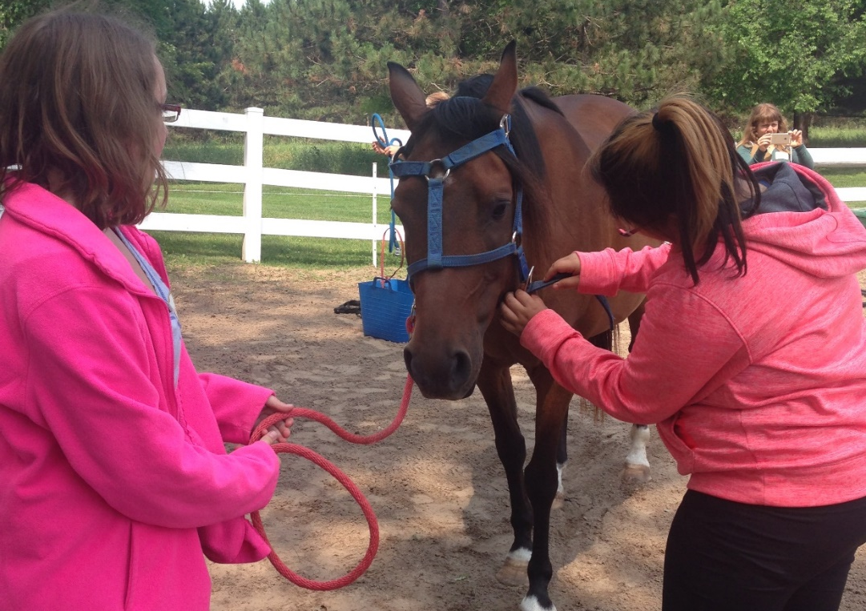
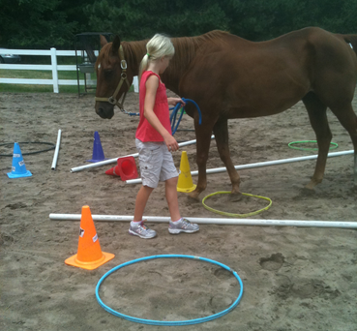
Provide Opportunities for Students to Make Choices
Deliberately choose how you set up the experience for clients/students and look at how many opportunities you provide them to make choices vs. the choices being made by the facilitators. Any time a directive is given to clients, it removes an opportunity of choice from the clients, and an opportunity to learn more about the clients as a result.
Notes:
A couple of key points:
Choice is a huge motivator. So what if the halter is on upside down? Does it work? Is it OK to do it a different way? What does that look like in school work?
What do YOU want to write about??? Which word & which meaning of that word do you want to use?? Where should it go in your story? What do YOU want to write about.

Slide 21
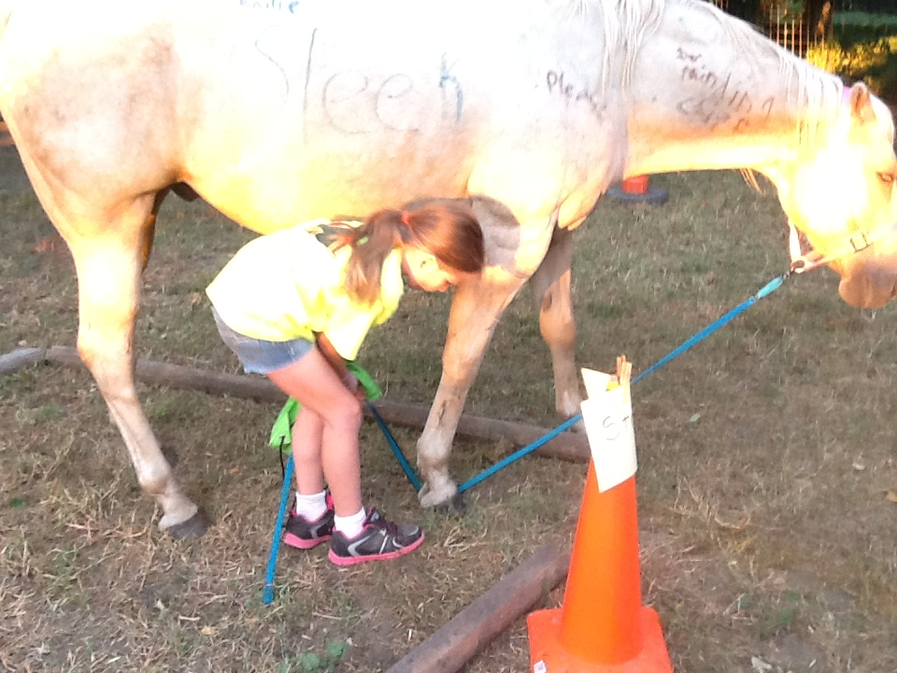
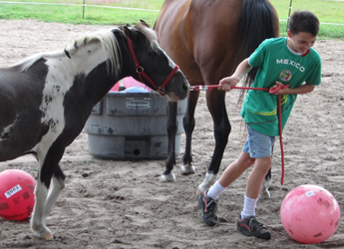
Productive Struggles build problem solving skills, persistence, and self-efficacy!
Notes:
How can students learn to solve problems if we jump in and do it for them???
Is it easy to watch them struggle? NO – but it is cruel NOT to allow them to learn from productive struggle!

Slide 22

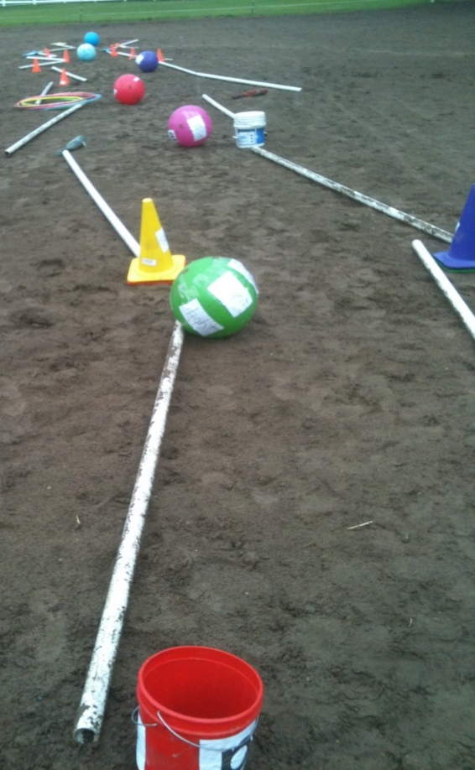
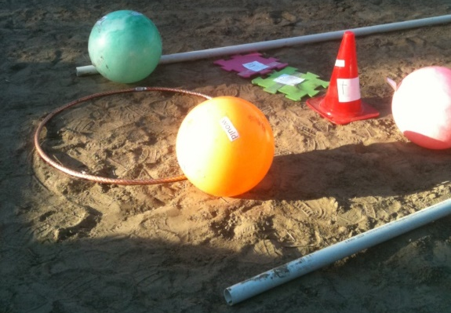
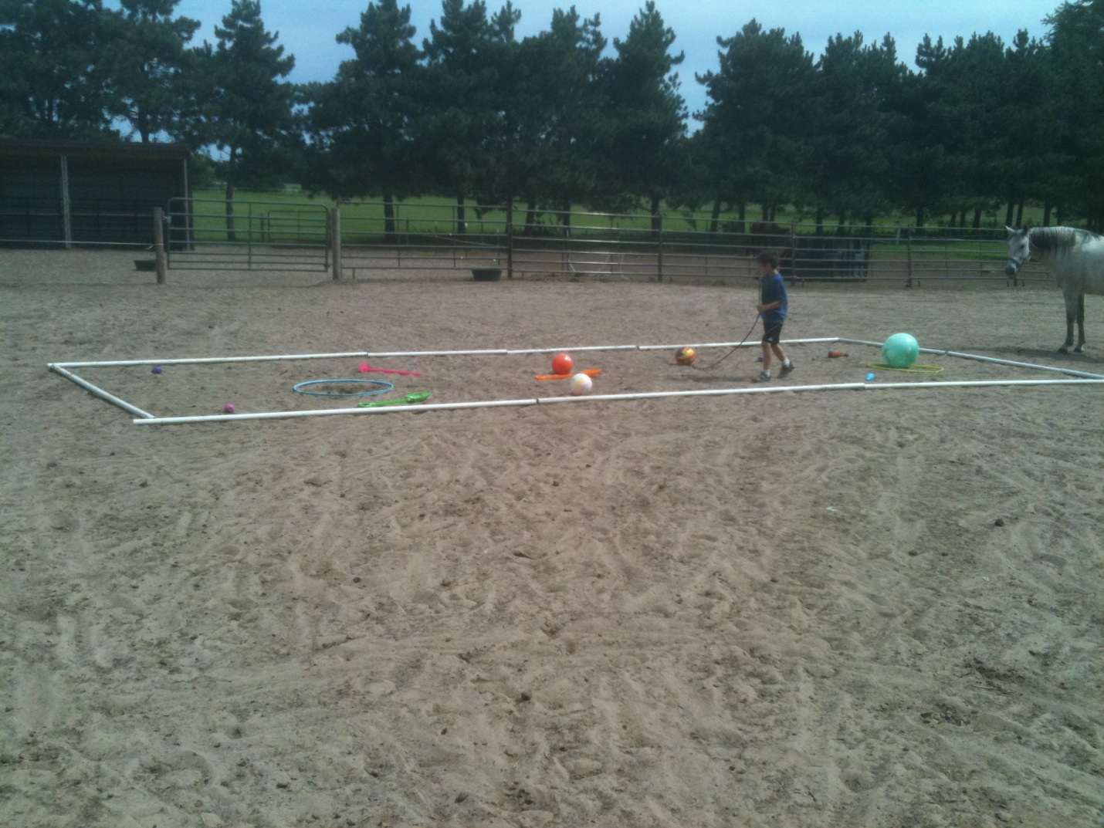
Obstacle Course
assessment, decoding, vocabulary, fluency
“writer’s / reader’s Block”
High anxiety!
No way in or out
Built in “escape routes”
Notes:
Just a few other “options”

Slide 23
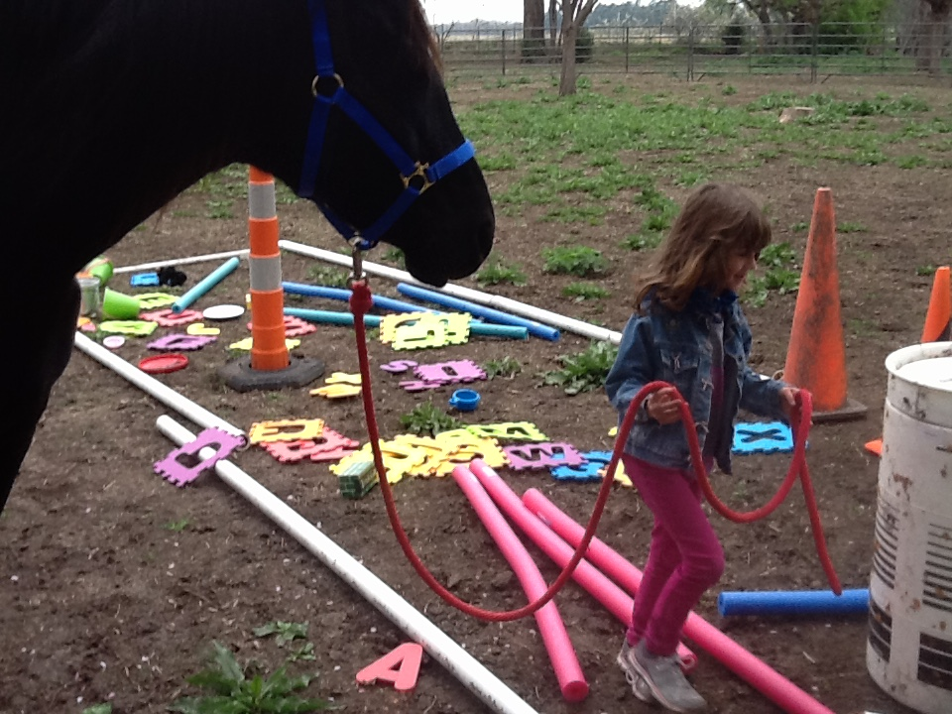
Her representation of a “chapter book”

Slide 24
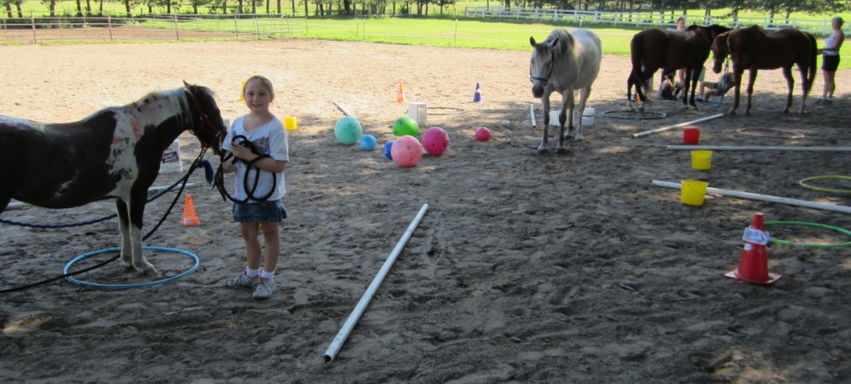
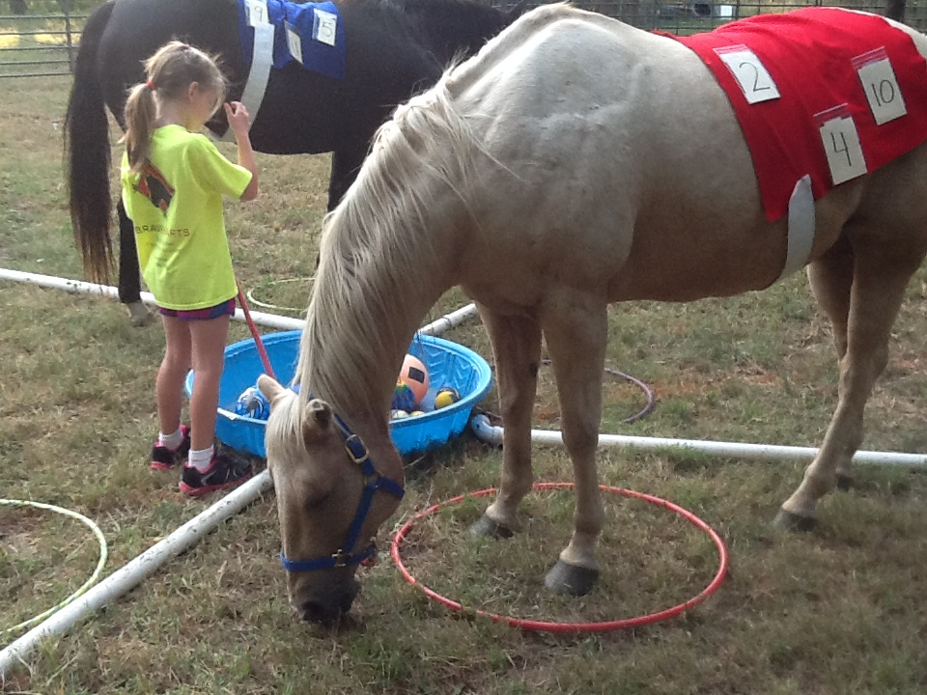
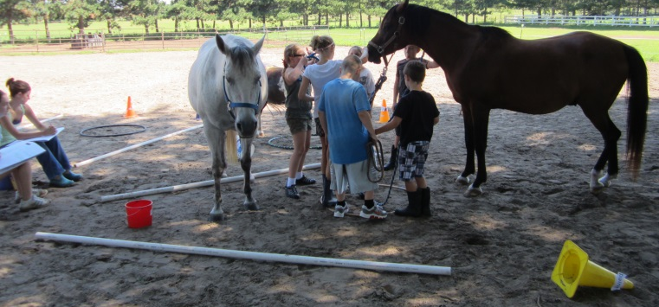
Comprehension
Story Circle
Basic facts + x
Math Ray

Slide 25
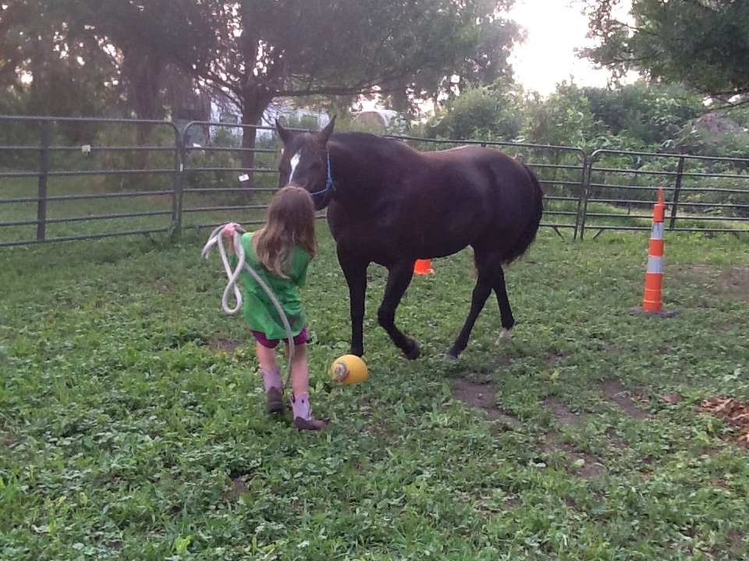
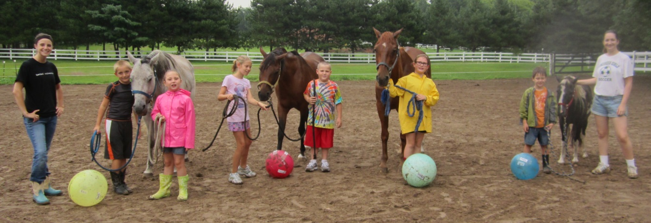
Math vocabulary words on a ball
Horse must kick halfway
Child kicks through a goal
Pick 2 or 3 words
Create a math sentence
Two plus three take away one equals four.
Adapt & change the game to fit the need.
Word families on a ball (take, cake, fake, etc)
  Or vocabulary words
  Or tricky words (come some home)(though, through, thought)
  Multiple meaning words (blaze, snip, paint)
Horse must kick halfway
Child kicks through a goal
Read all words – 1 point per word correct
Create a sentence using the word(s)
Horse soccer

Slide 26
Summer Fun Programs
K-5th grade Reading
Decode new words;
Read quickly, accurately, & with expression
Build Vocabulary
Overcome barriers blocking Comprehension
Middle School Reading:
Study Skills
Comprehending Text Books
Decoding unfamiliar words
Build Vocabulary
Higher Order Thinking
Critical & Creative Thinking
Horse Powered Field Trips
Equine Assisted Learning for PK, elementary, Middle School, High School, or even college students. Focus on the unique needs of YOUR class!
Reading,
Leadership,
Cooperation,
Team Building,
Problem Solving,
Bullying, or ???
Teacher Workshops: Journey to Literacy
Team building & learning exercise for school faculty

Slide 27
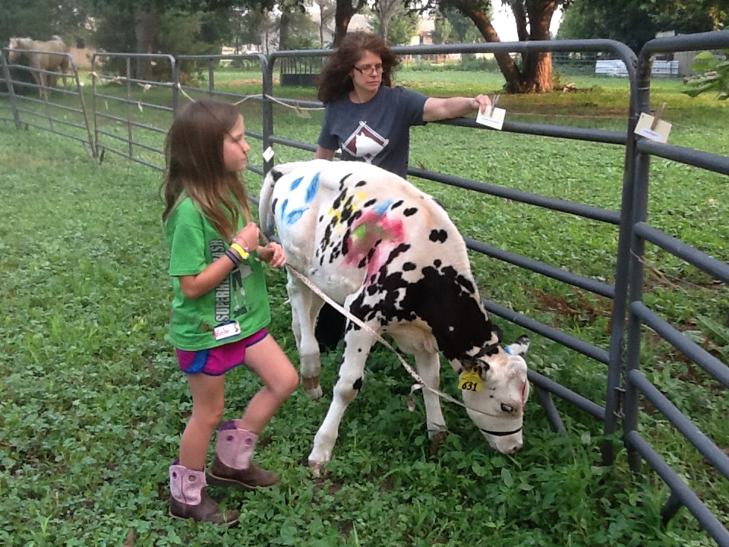
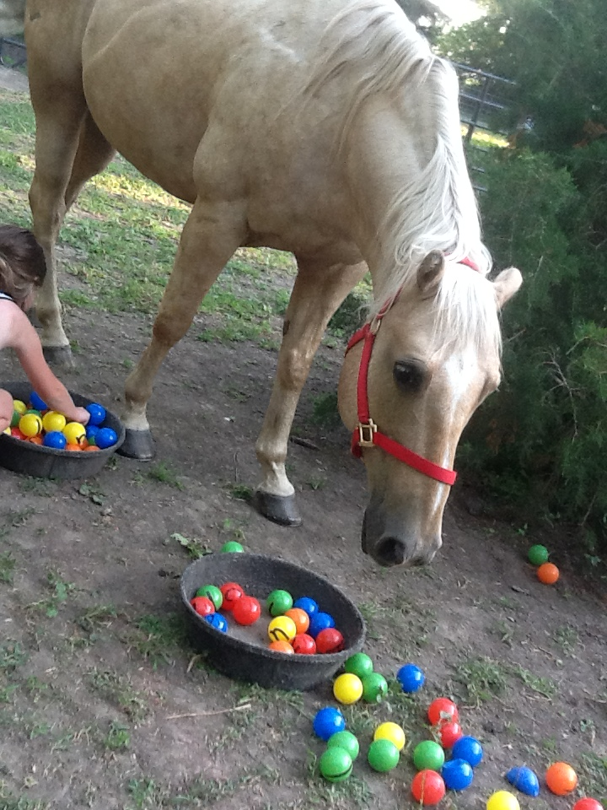
Start where you are.
Use what you have.
Do what you can.

Slide 28
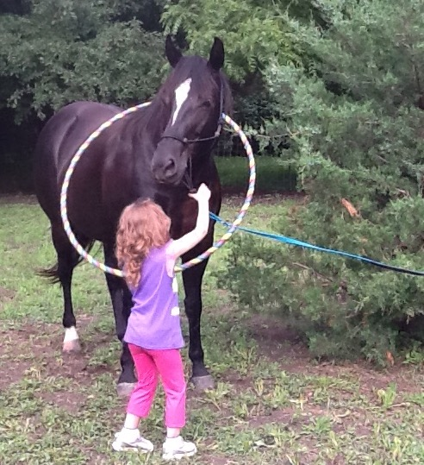
Trust
the
Process!

Slide 29
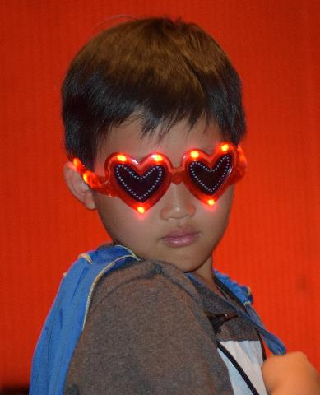
Describing the greatness you see…

Slide 30

Free Video e-Course
with NHA Creator,
Howard Glasser
“The 3 Stands™ of the Nurtured Heart Approach®”
www.ChildrensSuccessFoundation.com
Dr. Sally Baas, Advanced Trainer
Email: baas@csp.edu
Phone: 651-238-7570

Slide 31
Horse Powered Reading:
Intro to Experiential and Horse Powered Reading Instruction
SpringOnline Course offered: Mondays
7:00 – 9:00PM Central time
Phone: 651-343-5016 - www.crosspranch.com -
pickel@csp.edu
www.eagala.org
Dr. Michele Pickel - pickel@csp.edu
Cross P Ranch / Concordia University- St. Paul MN

