Slide 1
Implementing Efficient Writing Fluency Interventions in the Classroom
Carlos J. Panahon, Ph.D. & Samantha Steinman, Psy.D.
Minnesota State University, Mankato Mankato Area Public Schools

Slide 2
Outline
Introduction
  Writing
  CBM and scoring procedures
Interventions
  Performance Feedback
  Choice
  Combined Intervention
Implications for the School Psychologist
  Resources
  Data Collection
  Time
Questions

Slide 3
Introduction
According to the National Assessment of Educational Progress (NAEP), students are failing to perform proficiently
Differences in gender have been identified when looking at poor writing skills
  Females consistently outperform males on various writing tasks (Hier & Eckert, 2014)
NAEP 2003
  72% of 4th grade students
  69% of 8th grade students
  77% of 12th grade students
NAEP 2008
  67% of 8th grade students
  76% of 12th grade students

Slide 4
Impact of Poor Writing Skills
Students are at a greater risk in receiving lower grades in classes that require written responses to demonstrate their learning (Graham, Harris, & Mason, 2005)
May impact a student’s success in other academic areas such as social studies, math, and science (Graham et al., 2005)
Puts students at risk for behavioral concerns, school failure, or dropout (Hier & Exkert, 2004)
Are less likely to attend college or enter into the workforce as marketable employees (Graham et al., 2005).
Impact of poor writing skills is extended into the work setting (Coker & Ritchley, 2014)

Slide 5
Curriculum-based Measurement
Written Expression
Brief fluency measure
Provide a story starter
1 minute to think about the story
3 minutes to write
Scored and assessed based on writing skills being examined

Slide 6
Norms

Slide 7
Scoring Procedures
Total Words Written (TWW)
  Example: It was on Friday nite.
  Answer: 5 TWW
Words Spelled Correctly (WSC)
  Example: It was on Friday nite.
  Answer: 4 WSC
Correct Writing Sequences (CWS)
  Example: ^It ^ was ^ on ^ Friday ^ night ^.
  Answer: 6 CWS

Slide 8
Writing Interventions
Performance Feedback (PF)
Choice
Combined

Slide 9
Writing Interventions: PF
PF as an intervention:
  Can be used to specifically improve students’ writing fluency skills
  feedback is elaborate, specific, and explicit.

Slide 10
Research Evidence: PF
Eckert and colleagues (2006b) examined the effects of performance feedback condition compared to a control condition
  50 third grade students were randomly assigned to one group
  Students who received performance feedback demonstrated significantly greater increases in their TWW and CSW compared to students in the control group
Eckert and colleagues further examined the effects of frequency of PF
  42 students were randomly assigned to three conditions: (a) practice-only control; (b) PF once per week; and (c) PF three times per week
  Students who were provided PF either one or three times per week significantly improved their writing fluency compared to students who received no feedback.
  Amount of PF that was provided did not appear to result in significant differences in students’ fluency growth.

Slide 11
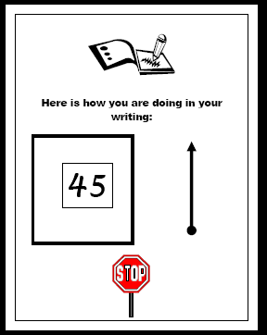
Writing Packet: PF

Slide 12
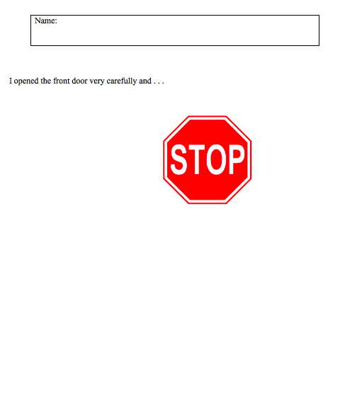
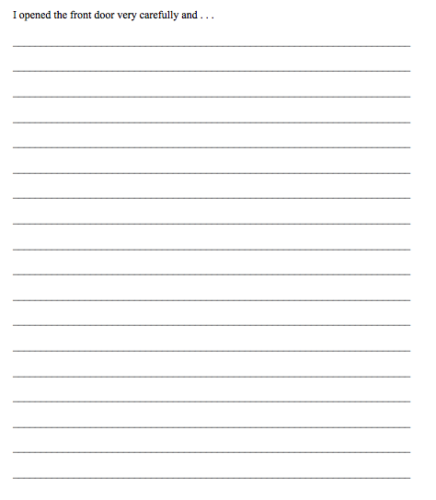
Writing Packet: PF

Slide 13
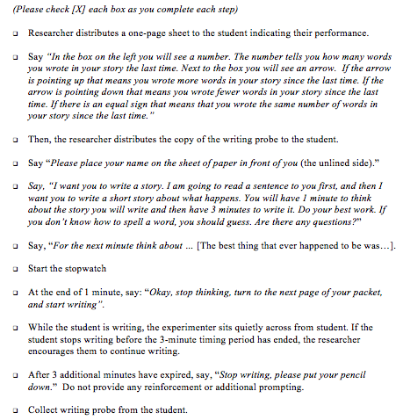
Writing Interventions: Implementing Performance Feedback

Slide 14
Strengths of PF as a Writing Intervention
PF can be:
  implemented with individual students, as a large-group writing intervention, or a combination of the two
  implemented into general instructional practices within a classroom
  used alone or in combination with other evidence-based writing interventions and strategies
Educators, School Psychologists, Interventions do not need to obtain extensive training in order to obtain encouraging results from the students

Slide 15
Writing Interventions: Choice
Choice as an intervention:
(a) the option to choose between academic or behavioral tasks
(b) order of completion of the task,
(c) choice of materials to use during the task,
(d) choice of who to interact with during work activities,
(e) choice of where to complete tasks, and
(f) time of day in which to complete a task
(Jolivette et al., 2001; Kern & State, 2009)

Slide 16
Writing Interventions: Choice
Providing choice as a writing intervention simply involves providing students with the opportunity to choose between two writing prompts to utilize as a basis for their writing responses during CBM writing sessions.
(Panahon, Hilt-Panahon, & Arbolino, 2012)

Slide 17
Research Evidence: Choice
2015: Investigating Gender Differences in Writing Studies Using Choice
Steinman, Panahon, Hilt-Panahon, & Arbolino
Results of a t-test indicated that male students had higher rates of improvement (M = 3.16, SD = 1.43), compared to females’ rates of improvement (M = 2.45, SD = 0.97) during Choice sessions. This difference was statistically significant, t(50) = -2.059, p = .045. In addition, no significant differences in the rates of improvement between males and females were found during No Choice sessions, t(50) = -0.291, p = .772.
2016: Using Choice as a Writing Intervention to Investigate Gender Differences
  Steinman, Schreiber, & Panahon
  Results indicated that providing choice improves students’ writing performances compared to those who are not provided with choice. Additionally, male students appear to benefit greatly when provided a choice.

Slide 18
Study 1: ROI TWW
Condition | Choice Sessions | No Choice Sessions
2nd Grade Females | -0.41 | -1.51
2nd Grade Males | 1.08 | -0.43
Average ROIs: | 0.48 | -1.00

Slide 19
Study 2: ROI TWW
Condition | Choice Sessions | No Choice Sessions
2nd Grade Females | 1.09 | none
2nd Grade Males | 1.95 | -0.78
Average ROIs: | 1.31 | -0.78

Slide 20
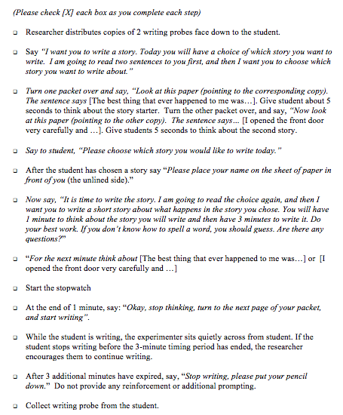
Writing Interventions: Implementing Choice

Slide 21
Writing Packet: Choice

Slide 22
Strengths of Choice as a Writing Intervention
Ease of implementation within the classroom setting in conjunction with standard CBM procedures.
Minimal changes to daily instructional time are required.
Minimal staff training for educators.
Successfully implemented at both the individual student level and at the class-wide level
Recent research indicates elementary-aged male students particularly benefited from this intervention.
(Kern & State, 009; Powell & Nelson, 1997; Kern, Bambara, & Vogt, 2002; Steinman et al., 2015)

Slide 23
Writing Interventions: Combined
Performance Feedback + Choice
Research focus: Would the combination of performance feedback plus choice lead to a greater improvement in students TWW compared to performance feedback and choice delivered individually?

Slide 24
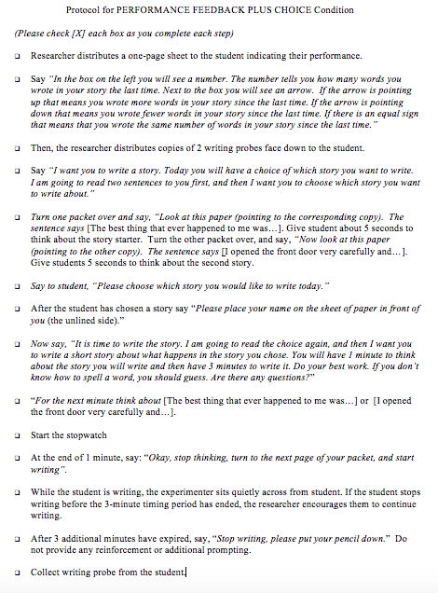
Writing Interventions: Implementing Performance Feedback + Choice

Slide 25
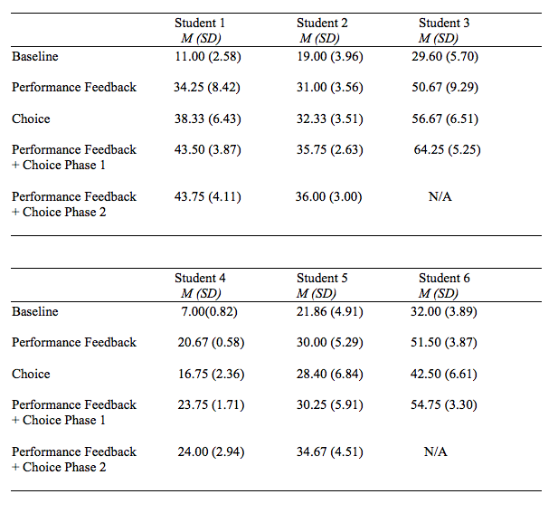
Research Evidence: Combined

Slide 26
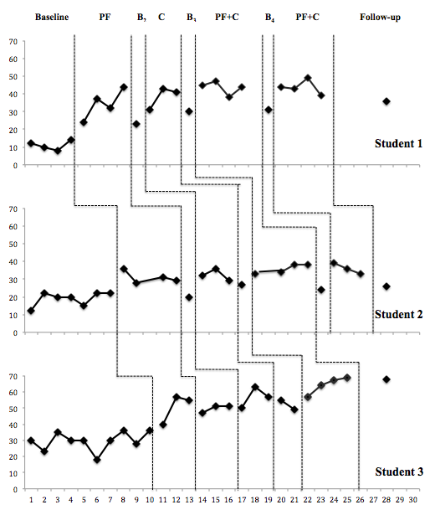

Slide 27
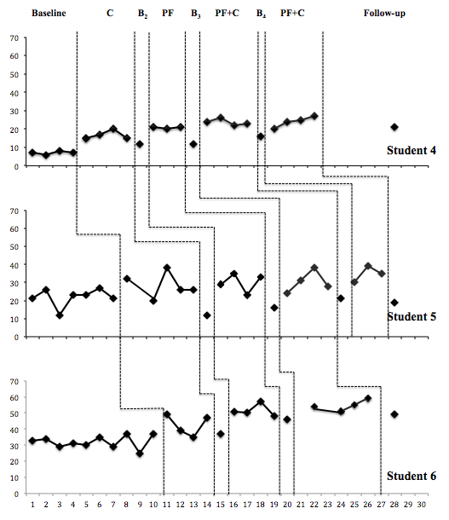

Slide 28
Research Evidence: Combined
Student | ROI (Expected = 0.35)
Student 1 | 3.38
Student 2 | 2.33
Student 3 | 4.33
Student 4 | 2.50
Student 5 | 1.56
Student 6 | 2.89
Average | 2.83

Slide 29
Implications for Practice
Practical writing interventions for elementary students that are easy and time efficient to implement
Increased rates of improvement
Minimal training and effort required for educators and support staff
Multiple format options for implementation (1:1, small group, and/or class-wide)
Data can be utilized as pre-referral interventions for special education assessments

Slide 30
General Implementation Process
Pre-Intervention
Schedule writing sessions/location
Identify story starters
During Intervention
Administer writing packet
Post-Intervention
Score writing sample (TWW, CWS, etc.)
Data entry
Data analysis
Prepare writing packets
Develop protocols
Complete all protocol steps
Collect writing sample

Slide 31
Writing Interventions: Resources
Resources for Story Starters
Intervention Central Writing Probe Generator
The ABCs of CBM: A practical guide to curriculum-based measurement. New York, NY: Guilford Press. Hosp, M. K., Hosp, J. L., & Howell, K. W. (2007).
AIMSweb
    Examples:
I opened the front door very carefully and ...
Yesterday the children went for a picnic and …
It was a hot, dry day and I had been walking for hours without food or water when ...
We were paddling on a beautiful lake in the woods when our boat tipped over and …
I waved out the window at my family as ...
Writing Packets and Protocols
Data Collection
Excel spreadsheet

Slide 32
Future Research
Examining the effects of performance feedback + choice (combined) implemented in a small group setting with 3rd grade students who struggle in the area of writing.
  Measures: TWW and CWS (quality of writing)

Slide 33
Questions and Comments
Contact Information:
Chip Panahon
E-mail: carlos.panahon@mnsu.edu
Samantha Steinman
E-mail: sstein1@isd77.k12.mn.us

