Slide 1
Academic Intervention in Schools: Addressing Barriers to Implementation
Shawna Petersen-Brown
1/26/18

Slide 2
Roadmap
Background:
The problem-solving model & academic intervention
Why are we doing this?
Why is it so difficult?
Addressing the barriers:
How will we make time?
Who will implement this?
How will we know it happened?
Conclusions

Slide 3
The problem-solving model & academic intervention
Back to where it all began…
Aptitude-by-treatment interaction
Deno & Mirkin, 1977
Short-run empiricism & precision teaching
Cronbach & Snow, 1977; Deno & Mirkin, 1977

Slide 4
Problem identification
Problem analysis
Implement modifications
Plan evaluation

Slide 5
Why are we doing this?
It’s the law!
MN Administrative Rules 3525.1341 Subp. 2: “The child must receive two interventions, as defined in Minnesota Statutes…”
2017 MN Statutes 125A.56 Subdivision 1.a.: “Before a pupil is referred for a special education evaluation, the district must conduct and document at least two instructional strategies, alternatives, or interventions using a system of scientific, research-based instruction and intervention… based on the pupil’s needs…”

Slide 6
Why are we doing this?
It helps students!
Meta-analysis of impact of prereferral intervention teams: d = 1.10 overall!
Student outcomes: d = 1.15
Systemic outcomes: d = 0.90
University-based: d = 1.32
Field-based: d = 0.54
Struggling students require more intensity, various ways to do this!
More time
Lower student:instructor ratio
Targeted to student needs
All or some of the above!
Burns & Symington, 2002; Foorman & Torgeson, 2001; NRP, 2000

Slide 7
Why is it so difficult?
What about fidelity to the problem-solving process?
Problem-solving teams respond to performance feedback
Some aspects of implementation are resistant to change
Burns, Peters, & Noell, 2008

Slide 8
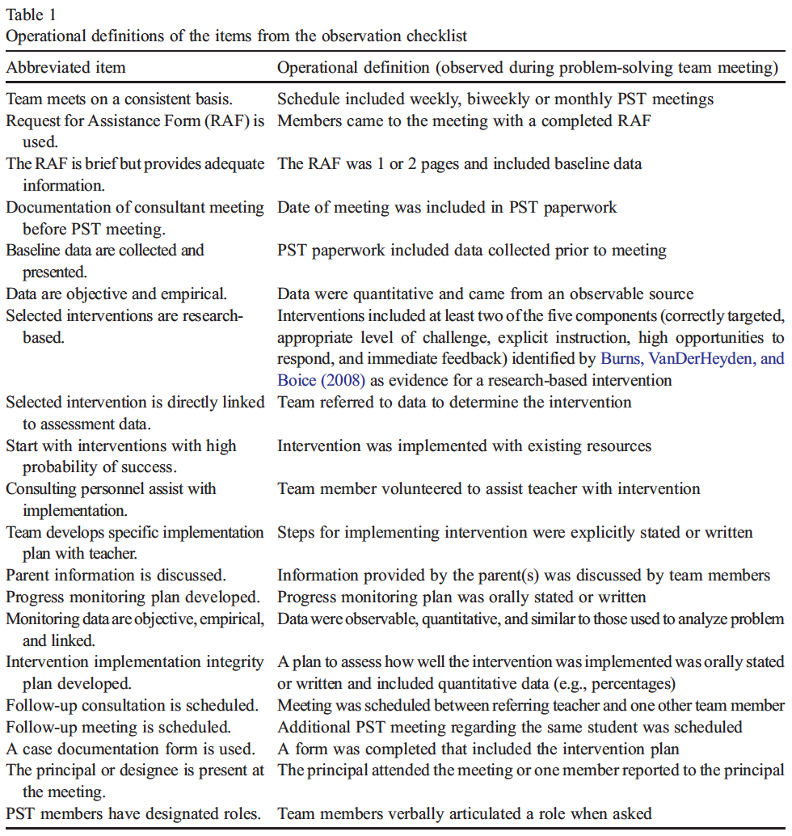
Burns, Peters, & Noell, 2008

Slide 9
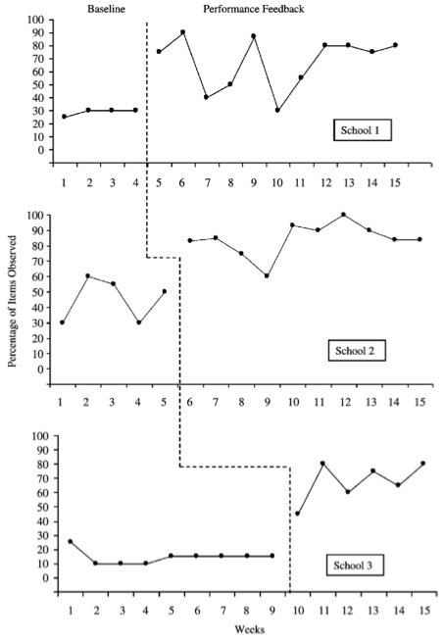
Burns, Peters, & Noell, 2008

Slide 10
Why is it so difficult?
What about fidelity to the problem-solving process?
Areas in which fidelity was high:
Documentation of the process
Including parents in the process
Areas responsive to feedback:
Selecting research-based interventions that are connected to the assessment data
Consultant assists with intervention implementation
Areas with limited responsiveness:
Implementation planning
Assessment of intervention integrity
Monitoring data are empirical and linked to the problem
Burns, Peters, & Noell, 2008

Slide 11
Problem identification
Problem analysis
Implement modifications
Plan evaluation
?
?
?

Slide 12
Why is it so difficult?
”To state the obvious, an intervention is effective only to the extent that it is implemented…” (Noell & Gansle, 2006)

Slide 13
Why is it so difficult?
Barriers to implementation
Not enough time
Not enough staff resources
…What else?

Slide 14
Addressing the barriers
Not enough time
Small group implementation
Computer- or tablet-based intervention
Not enough staff resources
Peer-mediated intervention
Paraprofessionals as interventionists

Slide 15
How will we make time?
“Work smarter, not harder.”

Slide 16
How will we make time?
Small group implementation
Intervention to 3+ targeted to common need
Moderate effect size, g = 0.54
Focus on small group interventions which...
Are targeted
Target elementary-aged students
Some aspects may not matter:
Hours of intervention
Who implements (assuming adequate training)
Hall & Burns, 2017

Slide 17
Repeated reading: Adapted for small group
Listening passage preview:
“We’re going to work as a group to become better readers. First, I’m going to read aloud. Follow along with your finger while I read.”
Choral read 1 with lead reader:
“The lead reader will read aloud, and the rest of the group will read along with the lead reader in a quiet voice. We will read the story three times, and each time a different student will be the lead reader.”
The lead reader reads aloud for 1 min from the beginning of the passage while the others also read along aloud. If any students are not reading with the lead reader, say, “Remember to read with the lead reader in a quiet voice.”
Delayed standard error correction:
Mark all errors any student makes.
Implement standard error correction for all the errors you marked. All students participate in error correction regardless of who made the error.
Choral reads 2 & 3 with delayed standard error correction:
Repeat steps 2 & 3 two more times with a different lead reader each time.
Repeat steps with the next portion of text
McComas et al., 2012

Slide 18
How will we make time?
Computer-aided instruction
Moderate effect size, d = 0.35-0.37
Focus on computer-aided interventions which:
Are a supplement to instruction
Provide a structured learning experience
Let the learner’s performance determine pacing
Provides explanation and remediation
Hattie, 2009; Tamim, Bernard, Borokhovski, Abrami, & Schmid, 2011

Slide 19
How will we make time?
Tablet-based instruction
Widespread and increasing!
58% implementing 1:1 initiatives
Despite limited empirical evidence
Perceived benefits:
Increased student engagement
Increased student achievement
Challenges in adoption:
Lack of training
Management of devices
Infrastructure issues
Interactive Educational Systems Design, 2014; Kajeet, 2017

Slide 20
How will we make time?
Tablet-based instruction
Moderate effect size, g = 0.60 and Tau-U = .83
Other meta-analyses have found general support for the use of tablets with students with disabilities
The body of research was too small to investigate moderators
Caution is warranted!
Ok & Kim, 2017; Petersen-Brown, Henze, Klingbeil, Reynolds, Weber, & Codding, 2017

Slide 21
How will we make time?
Tablet-based instruction:
One critical variable is ensuring apps are of high-quality!
Evidence-based?
Consistent with effective instructional elements?

Slide 22
Lamminen, Ray, Panahon, & Petersen-Brown, 2016

Slide 23
How will we make time?
Tablet-based instruction:
When tablet-based interventions are of high-quality, may be as effective as research-based analog intervention
Objective: Investigate multiplication fact fluency growth through classwide Cover-Copy-Compare and iPad interventions
Method:
21 4th-grade students, randomly assigned to CCC worksheet or iPad application
Practiced multiplication facts, 16 sessions, 5 min each
Results:
Showed comparable growth that exceeded ROI norms
iPad intervention was considered more acceptable/engaging to students!
Lamminen, Johnson, Petersen-Brown, & Panahon, 2017

Slide 24
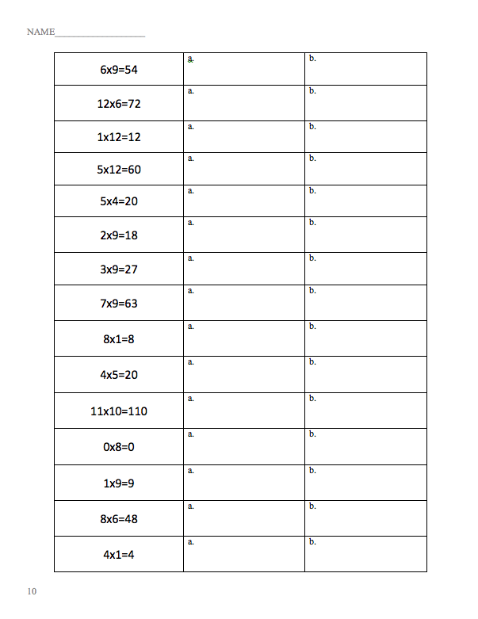

Slide 25
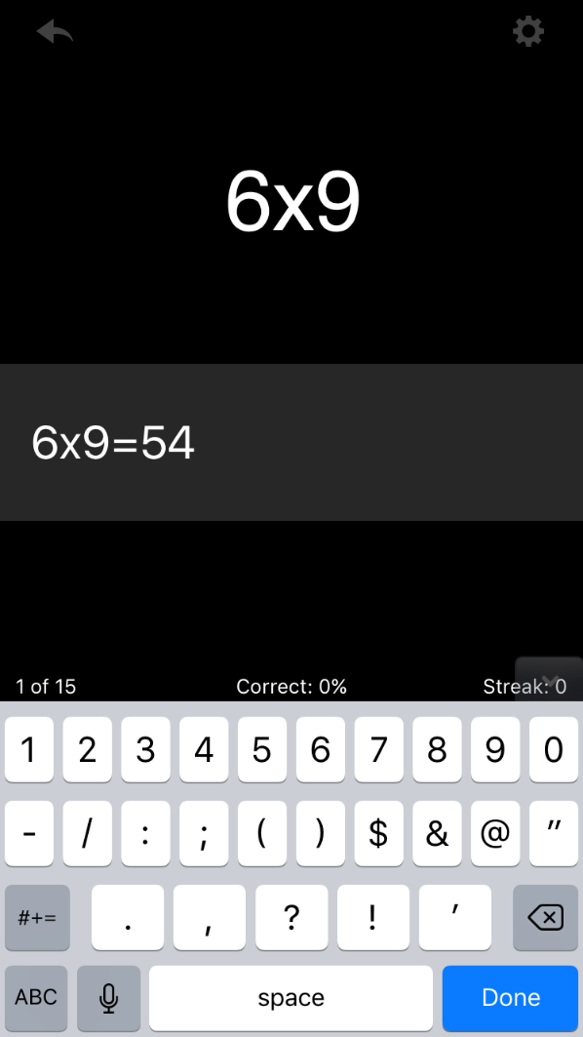
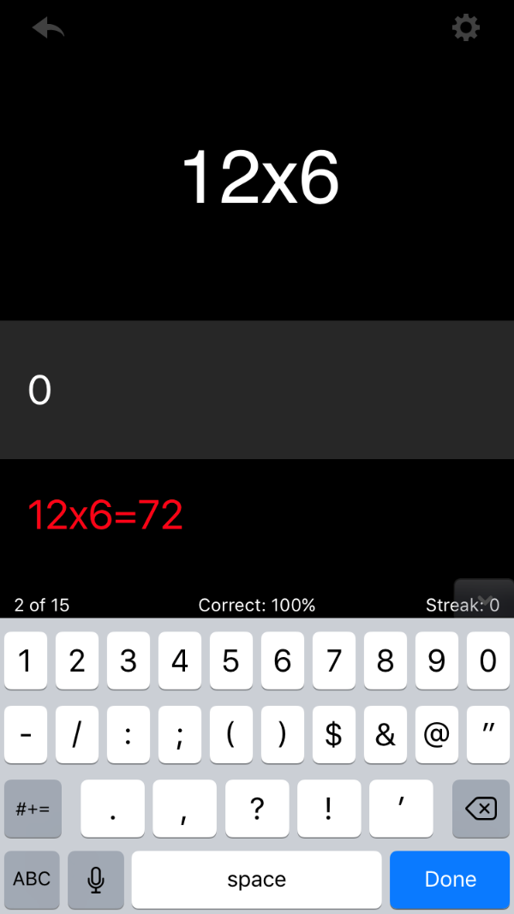
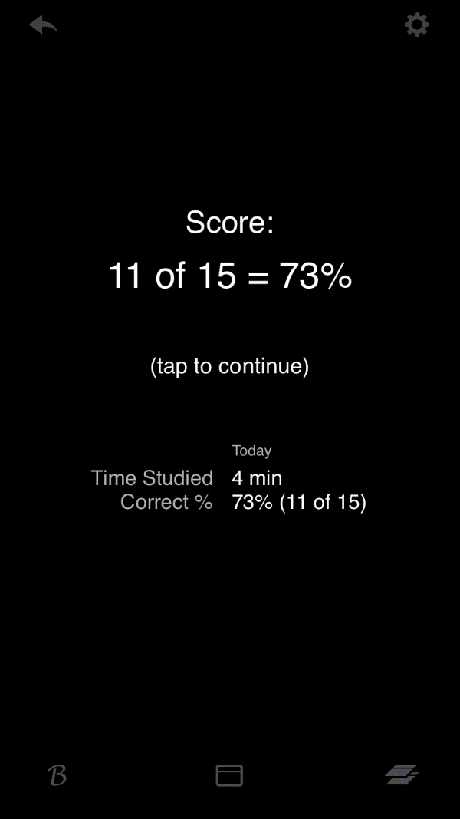

Slide 26
How will we make time?
Tablet-based instruction – overall recommendations:
Select apps that are of high quality
Evidence-based
Evaluated for use of effective elements
Targeted to specific student need
Provide training and supervision to students
Carefully monitor implementation and effectiveness

Slide 27
Who will implement this?
Don’t try to do everything yourself because you can’t!

Slide 28
Who will implement this?
Paraprofessionals as interventionists
90.6% of schools employ paraprofessionals
Para implementation as effective as teacher implementation for struggling readers
Similar to Reading Recovery
Paras are beneficial when they are trained on and implement specific strategies
Farrell, Alborz, Howes, & Pearson, 2010; Miller, 2003; U.S. DoE, 2007

Slide 29
Who will implement this?
Paraprofessionals as interventionists
Training is critical!
Many paraprofessionals lack training
Elements of effective training:
Verbal instructions
Modeling
Practice
Feedback
Giangreco, Edelman, & Broer, 2001; Rispoli, Neely, Lang, & Ganz, 2011

Slide 30
Who will implement this?
Paraprofessionals as interventionists:
Paraprofessionals may be well suited to implementing interventions which are effective, although intensive
Objective: Investigate paraprofessional effectiveness in implementing incremental rehearsal, an evidence-based flashcard intervention
Method:
2 3rd grade students struggling with word recognition
A paraprofessional implemented IR with high-utility sight words
Results:
Students retained more words during IR than baseline
The paraprofessional was able to implement the intervention with high fidelity (98.2%)
Petersen-Brown, Panahon, & Schreiber, 2017

Slide 33
Who will implement this?
Peer-mediated intervention
Moderate effect size, d = 0.55
Can be applied at a universal level (e.g., PALS, CWPT) or at a targeted level
Provides:
Frequent opportunities to respond
Increased academic engagement
Immediate feedback
Bowman-Perrott, Davis, Vannest, Williams, Greenwood, & Parker, 2013; Hattie, 2009

Slide 34
Who will implement this?
Peer-mediated intervention
Training is critical!
Verbal explanation
Modeling
Practice
Feedback
Selection of peer tutors
High status
Volunteer
Consistent attendance
Higher level of skill in the targeted area
Chan, Lang, Rispoli, O’Reilly, Sigafoos, & Cole, 2009

Slide 35
Who will implement this?
Peer-mediated intervention:
The efficiency of intensive interventions (such as IR) may be enhanced through peer-mediated implementation
Objective: Investigate peer effectiveness in implementing IR for sight words, an evidence-based flashcard intervention
Method:
2 2nd grade and 2 3rd grade students struggling with word recognition
4 3rd grade, high-achieving students served as peer tutors
Results:
Students retained more words during IR than baseline (TauU = 0.91)
Peer tutors were able to implement IR with fidelity (97.4%)
Klingbeil, Moeyaert, Archer, Chimboza, & Zwolski, 2017

Slide 38
How will we know it happened?
”If a tree falls in a forest and no one is around to hear it, does it make a sound?”
If an intervention is implemented and no one is around to observe it, how can we know it was actually implemented?

Slide 39
How will we know it happened?
Importance of monitoring treatment integrity
As barriers to implementation are addressed, monitoring of implementation is skill critical
As implementation deteriorates, interventions are less effective (or completely ineffective)
Noell & Gansle, 2006

Slide 40
Problem identification
Problem analysis
Implement modifications
Plan evaluation
?
?

Slide 41
How will we know it happened?
In monitoring treatment integrity
Self-report is insufficient!
Feedback is good
Daily feedback is best
Graphing implementation helps
Noell & Gansle, 2006

Slide 42
Problem identification
Problem analysis
Implement modifications
Plan evaluation

Slide 43
Conclusions
Consider
How we can make time:
Small-group implementation
Utilizing technology (e.g., tablets)
Who will implement this:
Paraprofessionals
Peers

Slide 44
Thank you! Questions?
Shawna Petersen-Brown
shawna.petersen-brown@mnsu.edu

